Slide 1
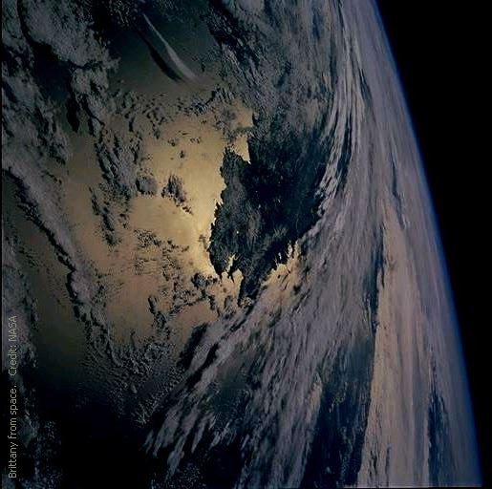
I C T M STUDY GROUP
SYMPOSIUM
MUSIC &
MINORITIES
RENNES, BRITTANY
JULY 4-8 2016

Slide 2
RENNES
*
Brittany is HERE

Slide 3
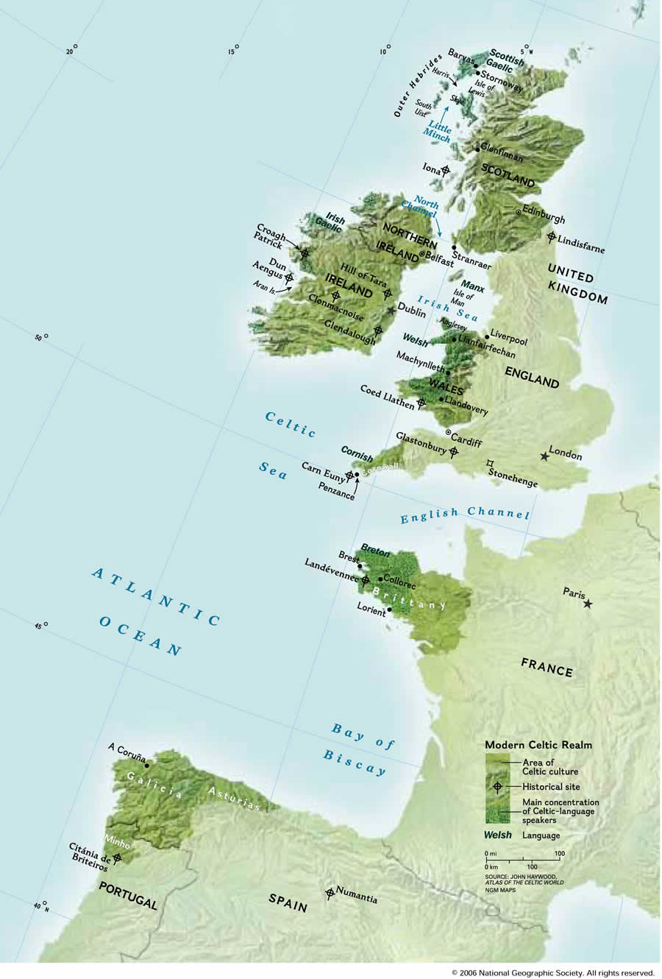
Brittany, Breizh,
at the crossroad
of the
Celtic Nations family

Slide 4
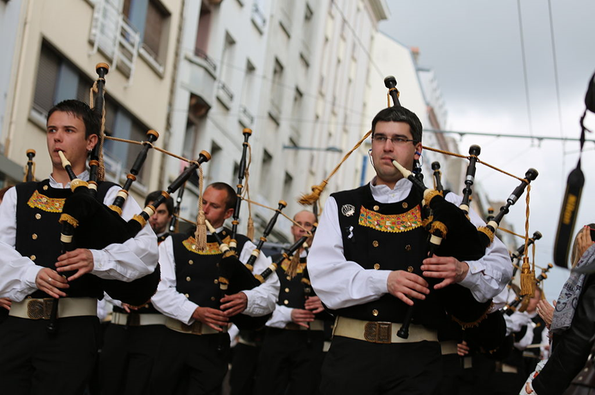
Music!
A true vehicle
of Breton identity...

Slide 5
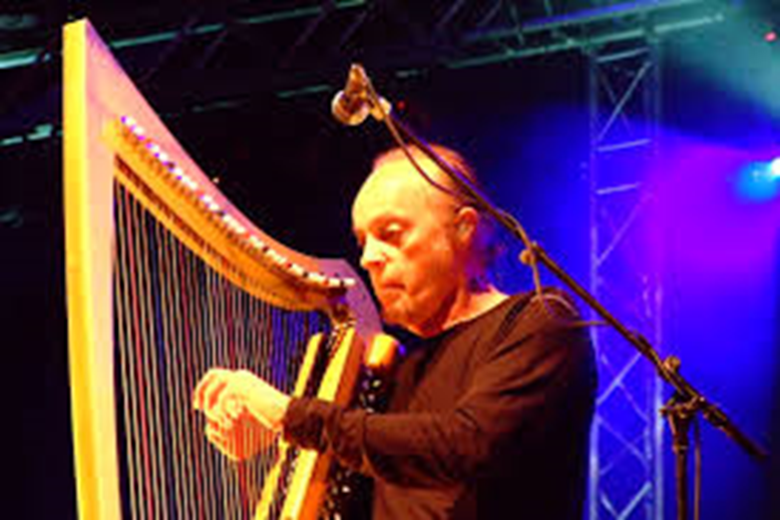
...and its path
to the World.

Slide 6
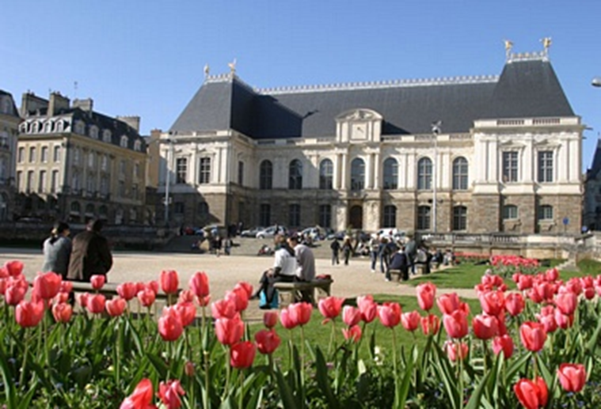
Rennes,
Roazhon, Brittany
A human size capital,

Slide 7
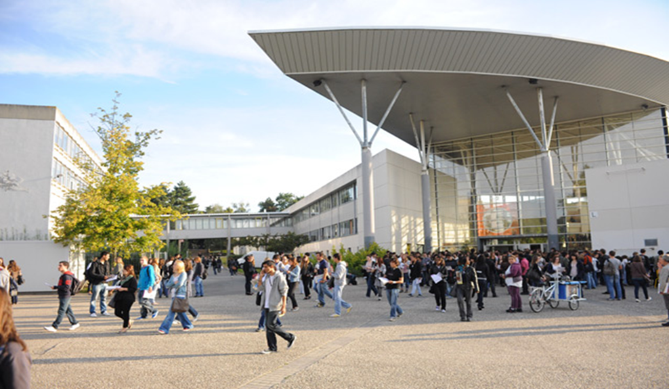
Where
Culture,
Education
History,
Infrastructures
Life quality
Meet

Slide 8
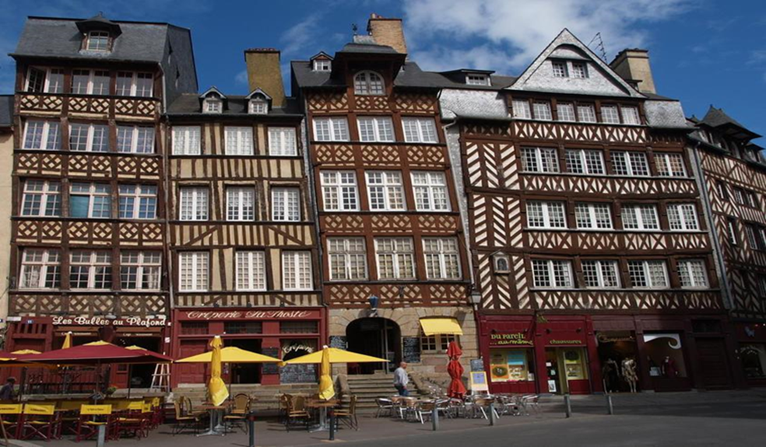

Slide 9
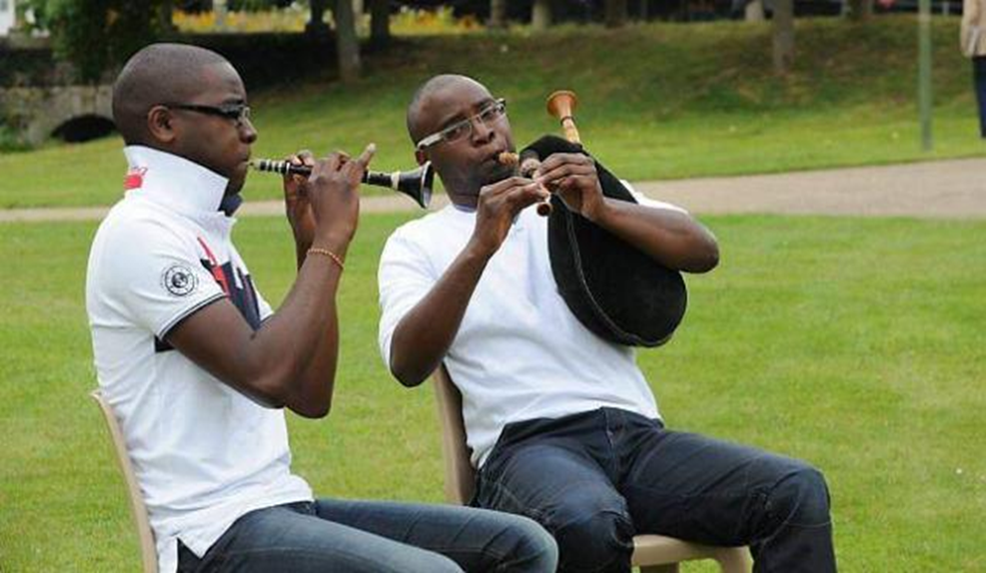

Slide 10
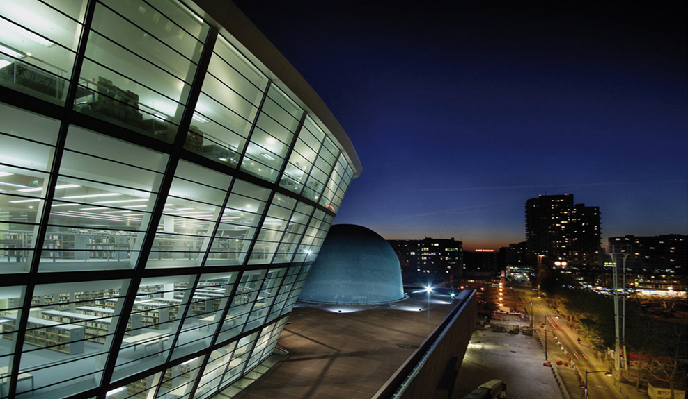

Slide 11
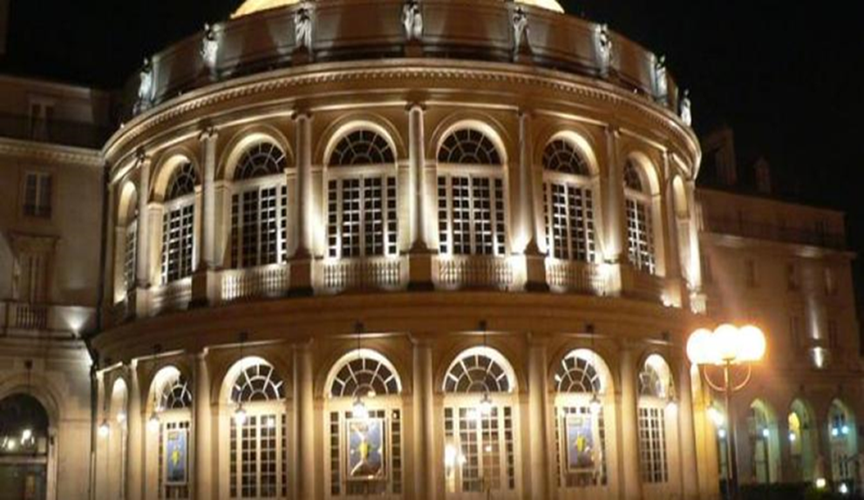

Slide 12
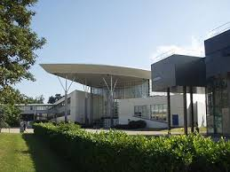
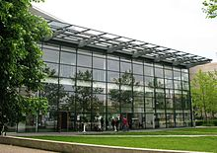
University Rennes 2 High-Brittany
Skol-Huel Roazhon 2 Breizh-Huel
Well equiped, modern, friendly,
Situated 10 min from your hotel
by tube

Slide 13
HOW TO GET THERE ?
Fly to Rennes International Airport ( RNS)
or
Fly to Paris Charles de Gaulle (CDG)
Then take the bullet train (TGV) to Rennes station
at CDG airport railways terminal (travel time: 3h)

Slide 14
ACCOMODATIONS:
All situated in downtown Rennes
ranging from 2* to 5* hotels
(~ 50 to 300 euros/ night)
Access: walking distances and by tube
Lunch on campus

Slide 15
Degemer mat e Breizh!
Looking forward to see you in Brittany!

